Slide 1
Dashboard title goes here
Title goes here
Title goes here
Title goes here
Title goes here
Title goes here
Title goes here

Slide 2
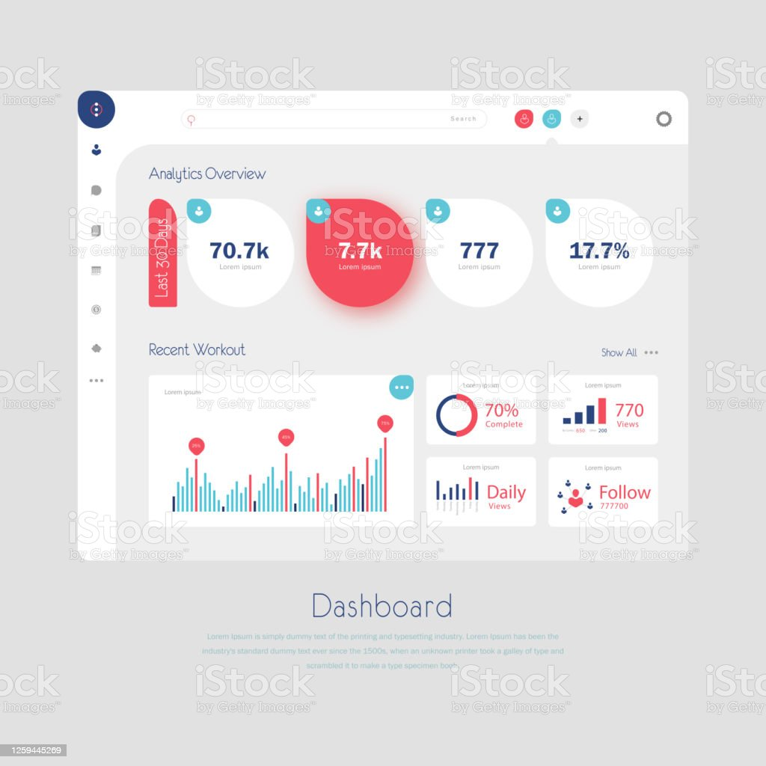
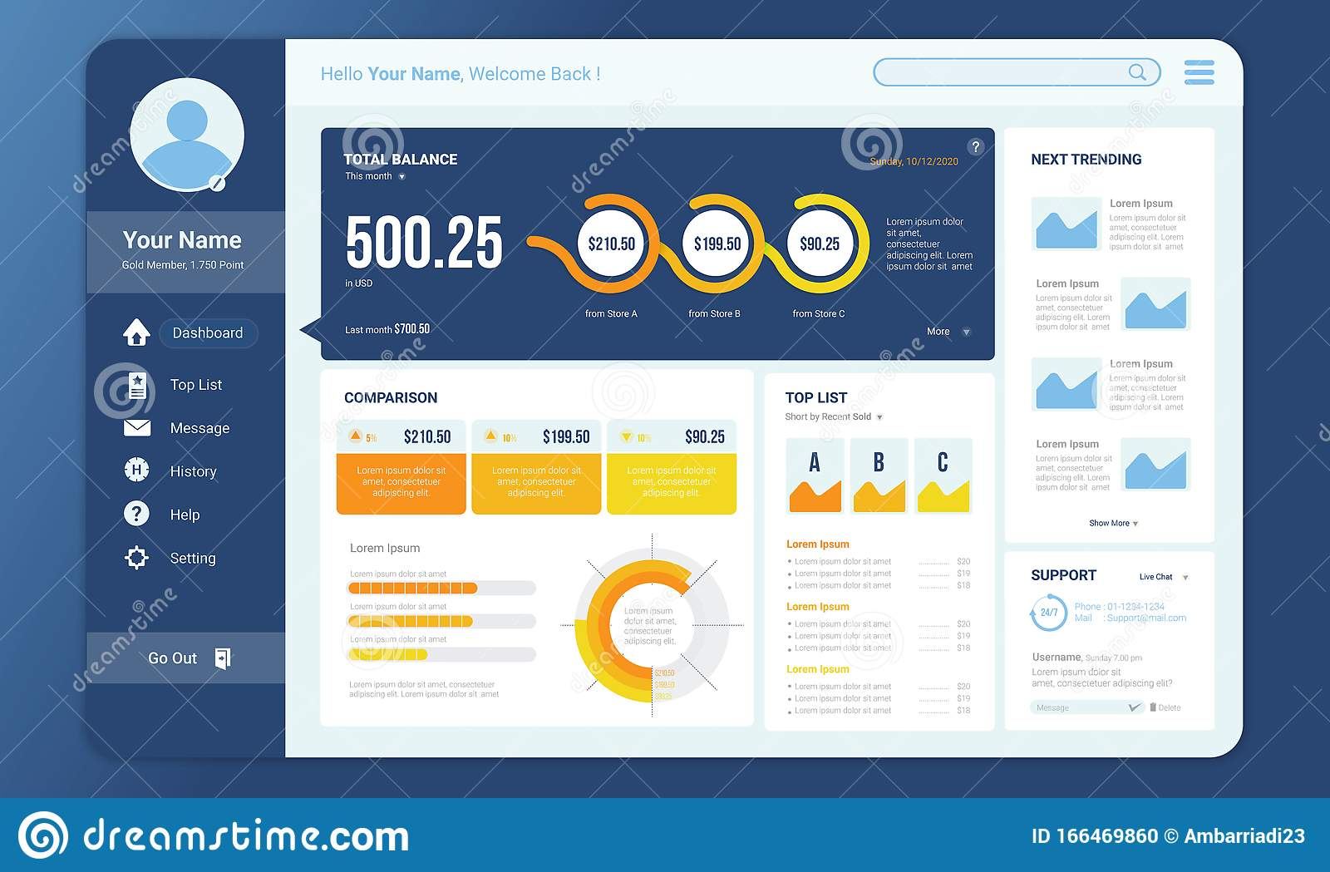

Slide 3
1
2
3

Slide 4



Real Estate
Properties values analysis

Slide 5



Property Management Dashboard
Real Estate
Properties values analysis
Over view
Locations
About

Slide 6







Property Management Dashboard
Real Estate
Properties values analysis
Over view
Locations
About

Slide 7

Property Management Dashboard
Real Estate
Properties values analysis
Over view
Locations
About

